Slide 1


PPEI
Project ……. Technical Proposal

Slide 2

Topics
01
About Senior Milenial Indonesia
02
Our Understanding
03
Our Solution
04
Our Timeline
05
Commercial

Slide 3

01
About SMI
01
About Senior Milenial Indonesia

Slide 4

01
Senior Milenial Indonesia
We are a company established since September 2021 with a millennial spirit to build a better Indonesia.

Slide 5



How we do it?
01
About SMI
Innovative Strategies
Strategic
Insights
Personalized Development
Clearly construct and establish the goals of your product development.
The discovery and application of insights is central to strategy.
We create technology to fill a void, need, or want.

Slide 6
Our Profile
01
About SMI
Mission
Vision
Values
To become a leading and trusted IT company as a reliable provider of Information and Communication Technology solutions.
Providing effective, efficient, and value-added information technology integration system solutions and services to the company and being the best partner in the development of information technology products and services, master plans and technology platforms.
Committed to delivering the best
Honest and transparent services
We care for your business just like ours
Keep learning and adapting to new technologies

Slide 7
01
About SMI
“Doing business responsibly and sustainably”
As a responsible company, we operate sustainably, to high Environmental, Social and Governance (ESG) standards. We continue to embed sustainability ever deeper in the way we do business – in our own operations and beyond, together with our partners.

Slide 8




Our services (1)
01
About SMI
Technology Consulting
Artificial Intelligence
Blockchain Technology
Platform Development
We are providing technologies consulting to our client to help our clients to achieve their target and also their visions with our best experts.
We help clients become streamline operations and reduce cost for better performance
We help clients find the best blockchain technology for your level and needs
Build apps on low code without compromising on scalability, security & performance.

Slide 9



Our services (2)
01
About SMI
Hardware Provider
Data Processing
Software Provider
Challenges abound when it comes to selling technology hardware and devices.
We provide end-to-end online data processing solutions to help you choose the right decision
Offer services to help businesses develop and create software based on the requirements

Slide 10
02
Our Understanding
02
Our Understanding

Slide 11
Our Understanding
02
Our Understanding
We understand PPEI as an educational and training institution, responsible to create and improve customer (Exporter) knowledge and experience to fulfill global market requirement.
In order to achieve this challenge, we discover that might an opportunity to improve current education and training program.
Key Challenge
Un-visualize real world scenario
Requirement of interactive features
Lack of interaction in education process

Slide 12
03
Our Solution
03
Our Solution

Slide 13
Transform tradition education into
Education Virtualization on Simulation Platform
Virtualization
Simulation
Splitting and transforming each cases or operation process into separate simulation Scenario
Conducting Simulation which imitates the operation of real-world processes or systems with the use of models.

Slide 14
Simulation Platform
Users
User (Importir)
Admin
. . .
Dashboard
Simulation Guidance
User Progress monitor
User Feedback service
Scenario
Studi kasus 1 : Ekspor Produk Ikan
Studi kasus 2 : Ekspor Produk furniture
Studi kasus 3 : Ekspor Produk kerajinan
Admin & Reporting
User Statistic
User Feedback manager

Slide 15
Simulation Platform (2)
Module
Form
Module (Importir by System)
Calculator Harga Export
Membuat Introduction Letter
Membuat Offering Letter
Menerima Ordering Letter
Membuat Sales Contract
Menerima LC
Menyiapkan Dokumen Export (Invoice, Packing List, Dokumen Lainnya)
Membuat Shipping Instruction
Membuat PEB
Mengurus Bill of Landing
Membuat SKA
Membuat Bank Draft
Penerimaan Uang
Export Calculator
Introduction Letter
Inquiry Letter
Offering Letter
Sales Contract
PPLC
LC
Invoice,
Packing List
Shipping Instruction
Delivery Order
PEB
NPE
B/L
SKA
Struktur Harga
Menerima Introduction Letter
Membuat Inquiry Letter
Menerima Offering Letter
Membuat Ordering Letter
Menyetujui Sales Contract
Membuat PPLC

Slide 16
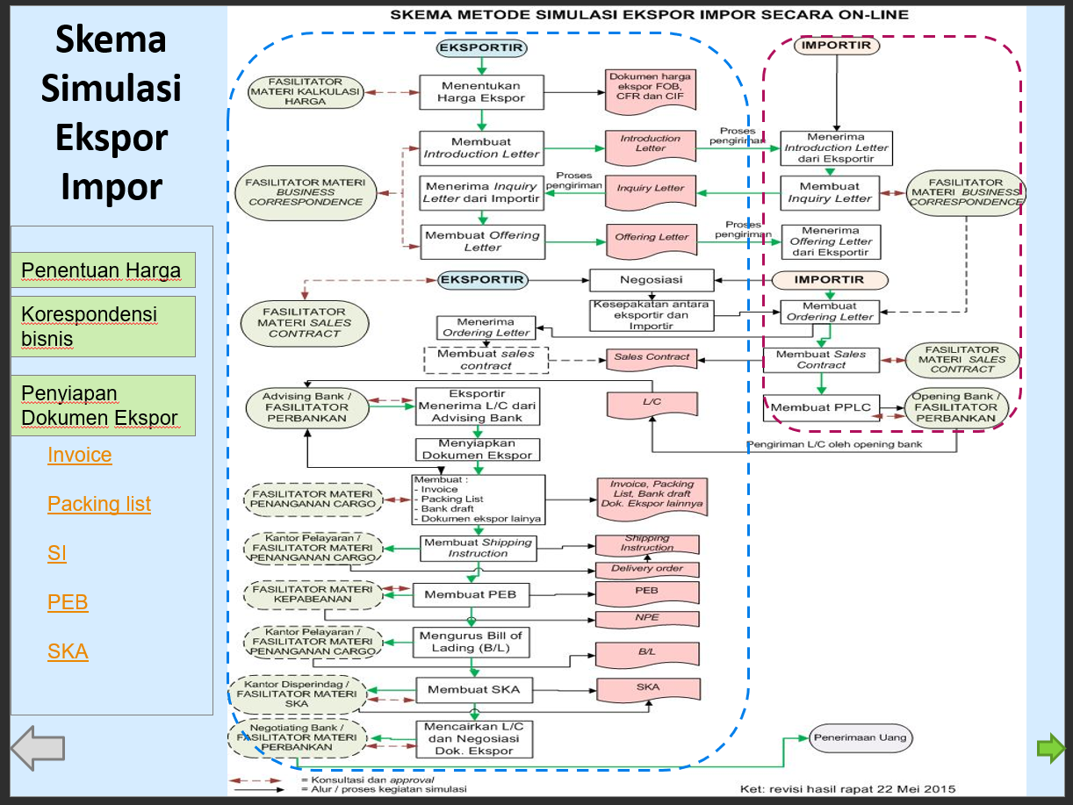
Simulation Platform (2)

Slide 17
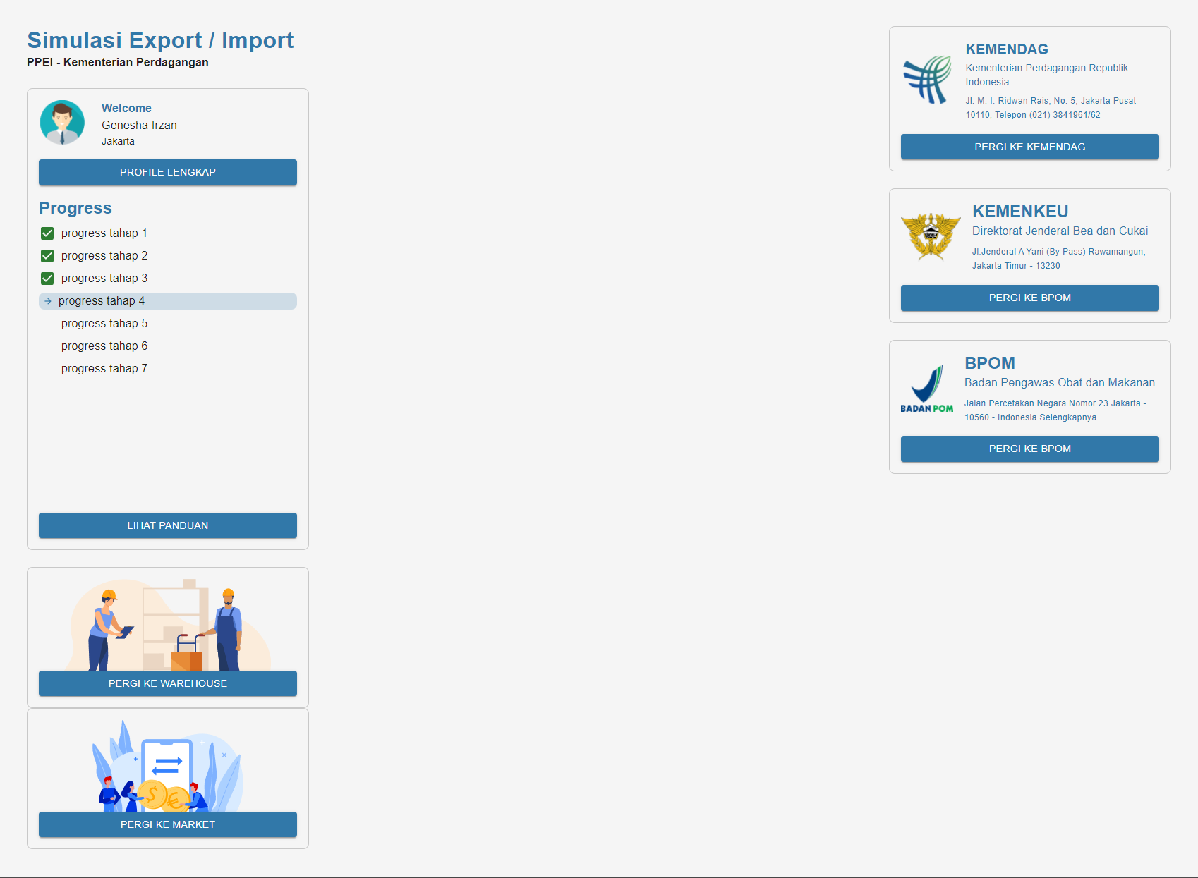
Initial Mockup
User Dashboard

Slide 18
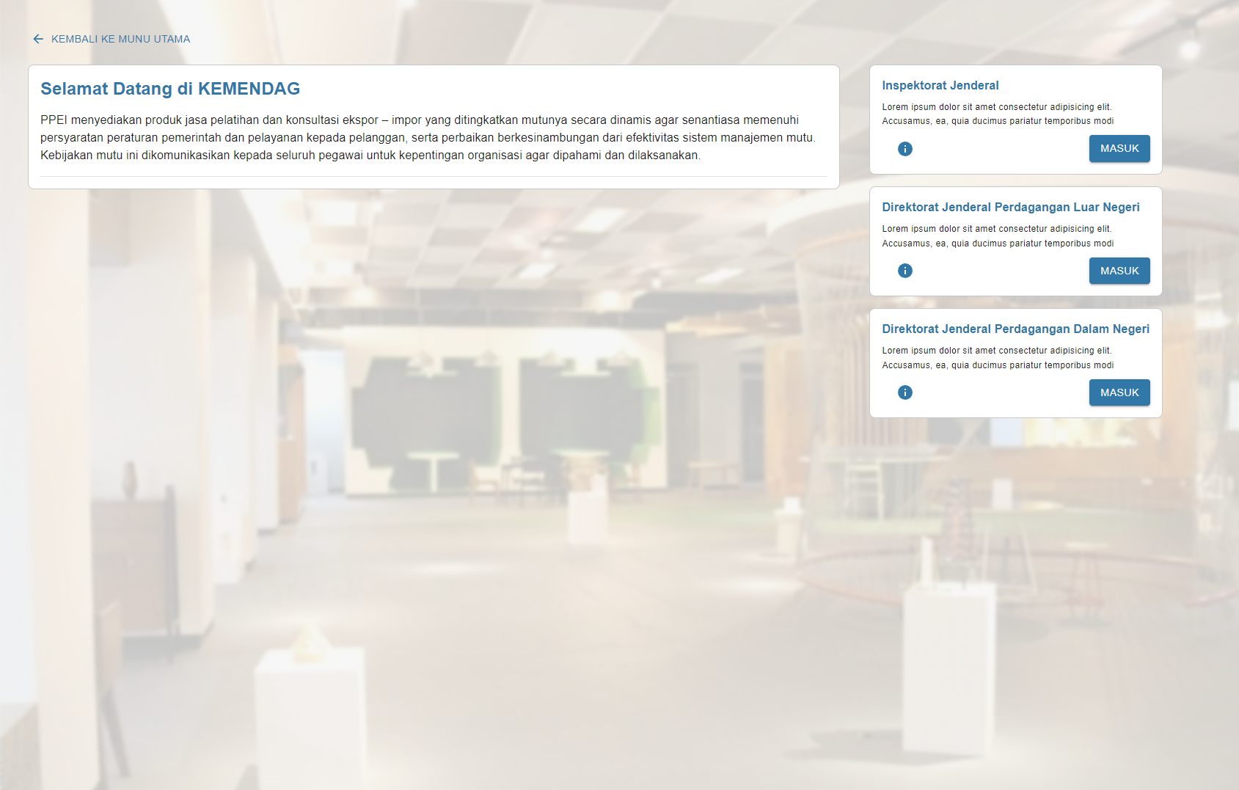
Initial Mockup
Virtual Kemendag

Slide 19
Frontend
React
Backend
Laravel
GraphQl
Deployement
AWS Cloud
Others
Git Repo
Technology in Use

Slide 20
04
Our Timeline
04
Our Timeline

Slide 21
Our Proposed Timeline
04
Our Timeline
We need total 12 weeks to do the assessment, recommendation and provide 1 project assistance in the beginning of the project (ini Contoh)
Activities
W#1 | W#2 | W#3 | W#4 | W#5 | W#6 | W#7 | W#8 | W#9 | W#10 | W#11 | W#12
Assessment
Setup & Team Deployment
Gather Information & Interview
Report Development
Recommendation
PMO Capabilities recommendation
Project Management Standardization
Report Standardization
Assistance
1 Pilot Project Assistance
Deliverables Review with Management

Slide 22
05
Commercial
05
Commercial

Slide 23
Our Professional Fee
05
Commercial
We have estimated our professional services for 12 weeks with our expertise as follows:
Description | Amount (IDR)
Professional Services (…Weeks)
VAT (11%)
Total | 80 000 000
Fees are included all related taxes
Any expenses (like hotels, trips if needed) are excluded from our professional fees, it will be charged to the client if needed

Slide 24

Thanks!
PT Senior Milenial Indonesia
Gedung Menara MTH Lt. 15 Unit 1508
Jl. Letjen MT Haryono Kav 23
RT 10 RW 09 Tebet Timur, Tebet, Jakarta Selatan
DKI Jakarta 12820
Telp. 021 - 83789544
Email : admin@sm-indonesia.id

